Slide 1
Universities and Innovation
Dr. Robert L. Caret
Chancellor
University System of Maryland
September, 2017

Slide 2
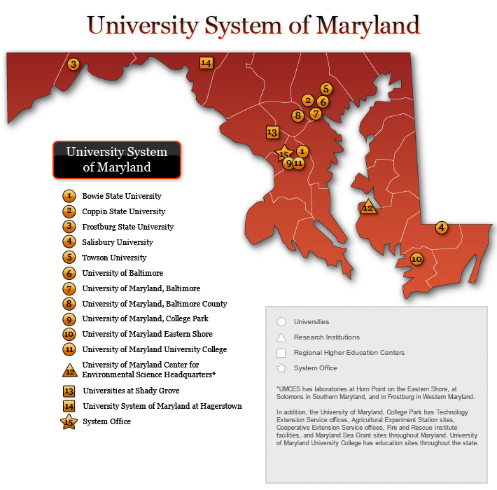

Slide 3
The USM and Maryland’s Workforce
University System of Maryland is:
12 campuses
173,000 students
38,000 graduates per year
80 percent from Maryland / 80 percent stay in Maryland
900,000 alumni in Maryland
USM Major Workforce Initiatives:
STEM
Cybersecurity
Health Professions
Notes:
Since FY 2009:
STEM enrollment from 22,220 to 35,716 - - - a 61% increase
STEM bachelors degrees issued from 3,520 to 6,441- - - an 83% increase
Sine FY 2009:
Cyber Degrees—at all level—have more than doubled, up over 115% to 5,200
Since FY 2009:
Health Professions degree production is up 40% to 2,800

Slide 4
The USM and Economic Development
New Board Committee (Economic Development & Tech Commercialization)
New Position (Vice Chancellor for Economic Development)
USM Ventures & Maryland Momentum Fund (University As Equity Investor)
Over $1.3 Billion In Research And Grant Funding Annually
3 Research Parks & 10 Business Incubator / Co-Working Facilities
550 Companies Facilitated Over The Past Five Years
Focus On Entrepreneurism: E-Novation, Excel Maryland, MIPS
Notes:
E and E outcomes (50000 foot):
- E&E: More than $500 million in cost savings & cost avoidance
- Course Redesign: 57 courses, $5.7M in savings, 143,000 students and 10,000 successful who would not have been (8 years)
- MOST: 60 faculty, 14 institutions, 3500 students , $142/course savings, $1M (3 years)
EdX Partnership: 5 Micromasters, MOOCs
New Companies / Over 500 created with an 70% survival rate for those that have secured $600M in follow-on funding. (8 years)
E-Novation Initiative / 8 faculty, over $8M in matching funds (50% of total over 2 years)
Excel MD Initiative / Co-Chair with JHU / Cyber and BioHealth targeted
MIPS / For 30 years MIPS funding for research and development projects teaming MD companies with university faculty to develop high-potential technology based commercial products. More than 6,600 direct, current jobs in Maryland and a cumulative $31 billion in product sales are attributable to companies whose early product development was supported by MIPS.
ALSO MENTION:
Fischell Medical Device Institute at UMCP
Brendan Iribe Computer Innovation Center at UMCP
SoMD Autonomous Technology R&D facility (new $80 million bldg.)
New Health Sciences bldgs. At UMB and Shady Grove

Slide 5
Tech Transfer and Commercialization
Harpoon Medical
Potomac Photonics
Gel-E
MF Fire
Living Pharma
Manta BioFuel
Notes:
Harpoon Medical (UMB) / Clinical stage medical device company that focuses in minimally invasive mitral valve repair. Has received a large investment from Edwards Lifesciences
Potomac Photonics (bwtech@UMBC) / A leader in laser micromachining, 3D Printing, micro hole drilling, micro CNC and other manufacturing technologies
Gel-E (UMCP) / gel-e products are engineered to stop bleeding quickly and conveniently using safe, naturally occurring biomaterials.
MF Fire (UMCP) / Out of the Fire Engineering program, a high-tech wood stove designed to burn more efficiently, while reducing carbon emissions and saving users money.
Living Pharma (UMB) / Developing cancer treatment that uses a patient’s own T-cells to target tumors. Recently acquired by Lentigen Technology, a life sciences company in Gaithersburg.
Manta Biofue (UMCES) / Aims to produce a clean alternative to petroleum crude oil by growing and harvesting algae in local ponds

Slide 6
Reinforcing Relationships with Stakeholder: Government, Industry, NGOs
Excel Maryland / New Statewide Economic Development Strategy
Academia, Private Industry, Government Working In Partnership
Business Higher Education Forum
Northrop Grumman / ACES - Undergraduate Cybersecurity Honors Program
Maryland Undergraduate Cybersecurity Network
RX5 Training
Public Private Partnership / Apprenticeships / Pathway To Jobs In Cyber Industry
Other Major Initiatives Include:
National Institute for Innovation of Manufacturing Biopharmaceuticals (NIMBL)
National Cybersecurity Center of Excellence (NCCoE)
Center for Research and Exploration in Space Science and Technology (CRESST)
Notes:
Medimmune Partnership (UMCP /UMBC / UMB)
Howard Hughes Foundation Initiative (Towson U)
$1 million over five years / inaugural Inclusive Excellence Initiative enhancing undergraduate, minority student success in the STEM disciplines
NIMBL: / More than 150 companies, educational institutions—including UMB & UMCP—nonprofits, and state governments will operate the institute
Backed by $250 million in funding, including a $70 million federal investment.
NCCoE: / First Federally Funded Research And Development Center For Cyber
A 25-Year, $5 Billion Partnership / USM, UMCP, & UMBC / NIST & MITRE
CRESST: / Consortium led by UMBC and UMCP
$87.5 million from the National Aeronautics and Space Administration (NASA) Goddard Space Flight Center.

